Slide 1

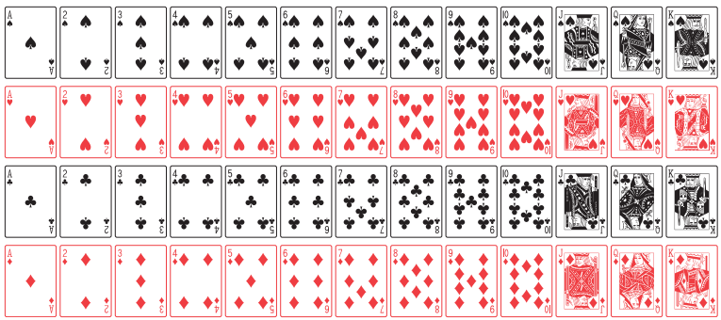
Introduction to Probability
Instructor
Osama Bin Ajaz
(osama.ajaz@nu.edu.pk)
Lecturer, S & H Dept.,
FAST-NU, Main Campus

Slide 2
Content
Sample Space and Event
Tree diagram
Set theory
Venn diagram
Counting techniques
Additive and multiplicative rules for probability
Conditional probability
Bayes’ Theorem

Slide 3
Sample Space
What is an experiment?
Any process or activity that generates a set of data is called experiment. For example:
Tossing a coin
Rolling dice
Playing cards
Opinion of voters
Launching of missiles

Slide 4
Sample Space
The set of all possible outcomes of a statistical experiment is called the sample space (S). For example:
Notes:
Tossing a coin, Die rolling, sample point

Slide 5
Tree Diagram
Tossing coin: 2 times, 3 times, 4 times
Tossing die & coin together:
Suppose that three items are selected at random from a manufacturing process. Each item is inspected and classified defective, D, or non-defective, N. List the elements of the sample space.

Slide 6
Events
An event is a subset of a sample space. For example:
The complement of an event A with respect to S is the subset of all elements of S that are not in A. We denote the complement of A by the symbol A’.
Notes:
Rolling die and number less than 4 occurs.
Smokers, nonsmokers, light smoker, heavy smokers

Slide 7
Intersection of Events
The intersection of two events A and B, denoted by the symbol A ∩ B, is the event containing all elements that are common to A and B.
Let E be the event that a person selected at random in a classroom is majoring in engineering, and let F be the event that the person is female. Then E ∩ F is the event of all female engineering students in the classroom.
Let V = {a, e, i, o, u} and C = {l, r, s, t}; then it follows that V ∩ C = φ. That is, V and C have no elements in common and, therefore, cannot both simultaneously occur.

Slide 8
Mutually Exclusive events
Two events A and B are mutually exclusive, or disjoint, if A ∩ B = φ, that is, if A and B have no elements in common.

Slide 9
Union of events
The union of the two events A and B, denoted by the symbol A∪ B, is the event containing all the elements that belong to A or B or both.
Let A = {a, b, c} and B = {b, c, d, e}; then A ∪ B = ?
Let P be the event that an employee selected at random from an oil drilling company smokes cigarettes. Let Q be the event that the employee selected drinks alcoholic beverages. Then the event P ∪ Q =?

Slide 10
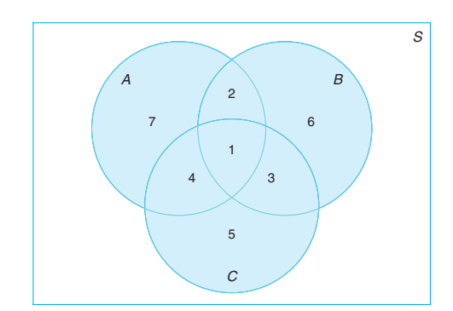
Venn Diagram
A ∩ B = B ∩ C = A ∪ C = B’ ∩ A = A ∩ B ∩ C = (A ∪ B) ∩ C’ =
1, 2
1, 3
1,2,3,4,5,7
4, 7
1
7,2,6,

Slide 11
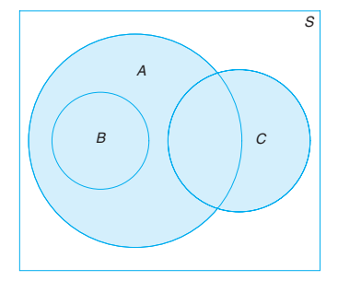
Venn Diagram
B ∩ C =
A ∪ B =
A ∩ C =
Null Set
A
At least one element

Slide 12
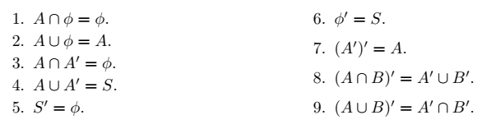
Venn Diagram
Several results that follow from the foregoing definitions, which may easily be verified by means of Venn diagrams, are as follows:

Slide 13
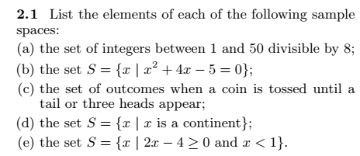
Notes:
(a) {8, 16, 24, 32, 40, 48} (b) (x+5)(x-1) = 0, S = {-5, 1} (C) {T, HT, HHH} (e) S = null set

Slide 14
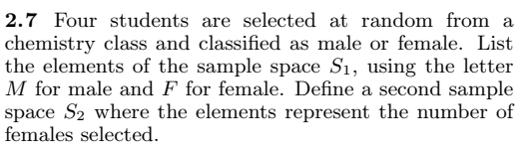
Notes:
S1 = { MMMM, …, FFFF} S2 = { 0, 1, 2, 3,4}

Slide 15
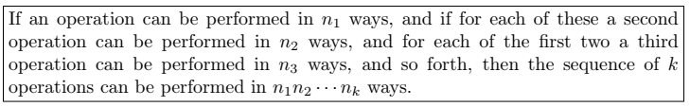
Multiplication Or Fundamental Rule of counting
How many sample points are there in the sample space when a pair of dice is thrown once?
How many three digit numbers can be formed from the digits 2, 4, 6, and 8 if: (i) repetitions are not allowed (ii) repetitions allowed
Notes:
(a) 36 (b) 24 & 64

Slide 16
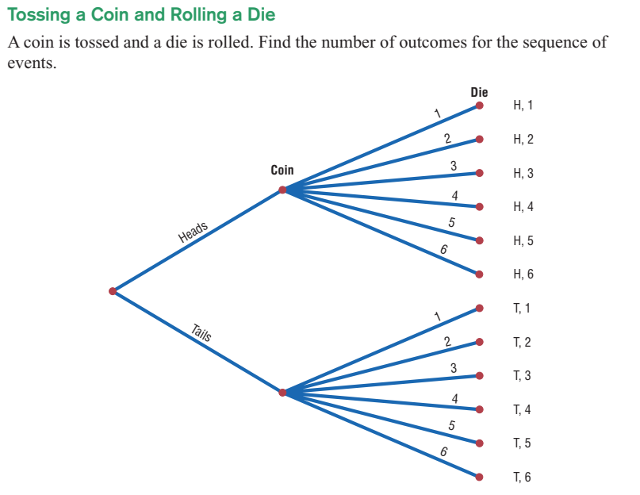
Example:

Slide 17
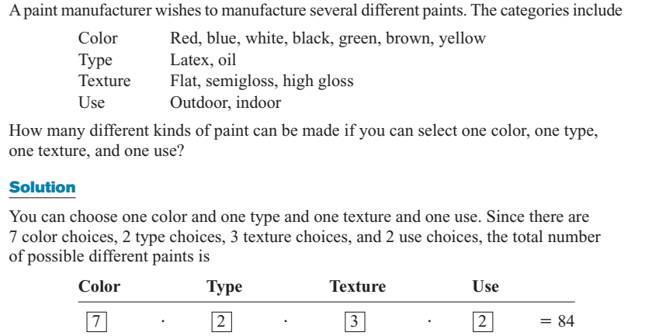
Example: Types of Paint

Slide 18
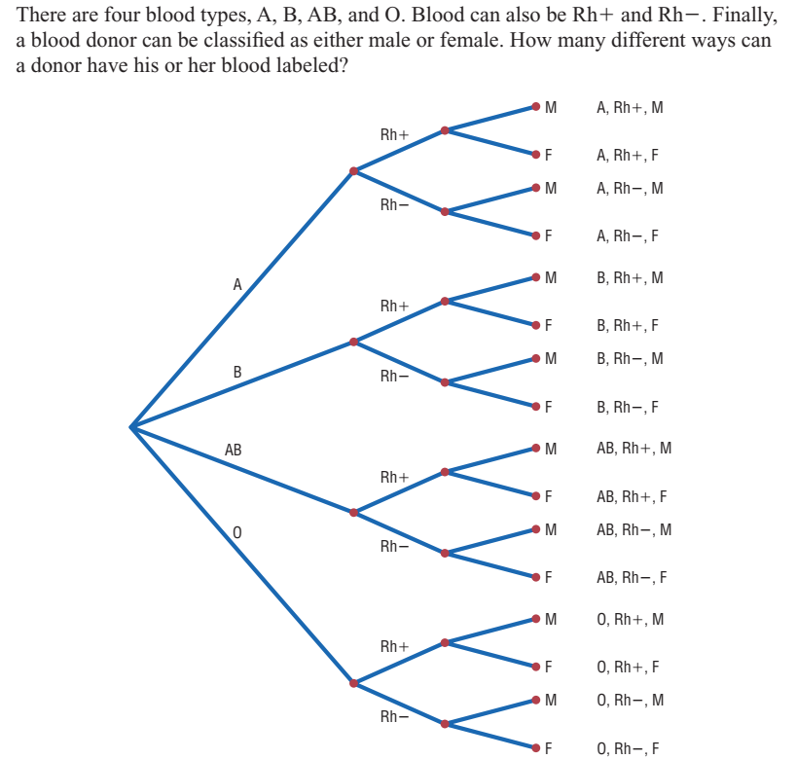

Example:
Distribution of Blood Types

Slide 19
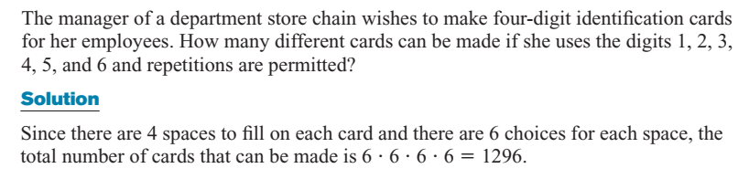


Example: Identification of Cards

Slide 20
Set of Example (iii - viii)
(iii) A developer of a new subdivision offers prospective home buyers a choice of Tudor, rustic, colonial, and traditional exterior styling in ranch, two-story, and split-level floor plans. In how many different ways can a buyer order one of these homes?
(iv) If a 22-member club needs to elect a chair and a treasurer, how many different ways can these two to be elected?
(v) Sam is going to assemble a computer by himself. He has the choice of chips from two brands, a hard drive from four, memory from three, and an accessory bundle from five local stores. How many different ways can Sam order the parts?
(vi) How many even four-digit numbers can be formed from the digits 0, 1, 2, 5, 6, and 9 if each digit can be used only once?
(vii) How many new arrangements can be made from the letters of the word FAVOUR so that vowel occupy even place.
Notes:
(iii) 4 x 3 = 12 ways (iv) 22 x 21 = 462 (v) 2 x 4 x 3 x 5 = 120 ways (vi) (5 x 4 x3 x1)*(4 x 4 x 3 x 1)*(4 x 4 x3 1) = 156 (vii) 36

Slide 21
Permutation
A permutation is an arrangement of all or part of a set of objects.
The number of permutations of n objects is n!.
Suppose you have to arrange 3 books: Statistics, Maths, Physics on a shelf. How many arrangements are possible?

Slide 22

Permutations of “n” objects taken “r” at a time
In one year, three awards (research, teaching, and service) will be given to a class of 25 graduate students in a statistics department. If each student can receive at most one award, how many possible selections are there?
Notes:
25P3 = 13800

Slide 23
Example # 10:
A president and a treasurer are to be chosen from a student club consisting of 50 people. How many different choices of officers are possible if
(a) there are no restrictions;
(b) A will serve only if he is president;
(c) B and C will serve together or not at all;
(d) D and E will not serve together?
Notes:
(a) 50 x 49 = 2450 (b) 49 + 49P2 = 2401 (c) 2 + 48P2 = 2258 (e) 2450 – 2 = 2448

Slide 24

Circular Permutations
The number of permutations of n objects arrange in a circle is (n –1 )!.

Slide 25
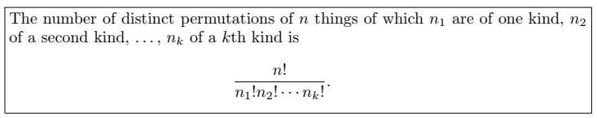
Permutations of n objects when they are not all different.
Find the number of permutations of 9995
In how many ways can the letters of the word STATISTICS be arranged?
In how many ways can 2 red, 3 blue, and 4 green chips be arranged in a row, if the chips of same color are not distinguishable from each other?
Notes:
(i) 4 (ii) 50,400 (iii) 1260

Slide 26
In a college football training session, the defensive coordinator needs to have 10 players standing in a row. Among these 10 players, there are 1 freshman, 2 sophomores, 4 juniors, and 3 seniors. How many different ways can they be arranged in a row if only their class level will be distinguished?
Notes:
12600

Slide 27

Combinations
Selection of “r” objects from “n” different objects and when the order is not important.
In how many ways a committee of 3 students can be selected from 4 students.
From a group of 10 boys and 6 girls a committee of 3 boys and 2 girls are to be selected. In how many ways can this done?
Notes:
4C3=4 (b) 120 x 15 = 1800 ways

Slide 28
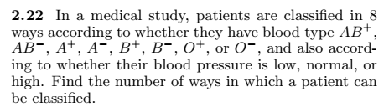
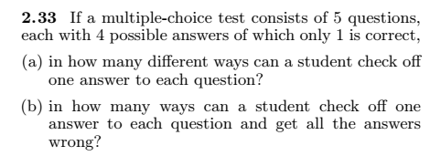

Exercises
Notes:
(2.22) 8*3 = 24 (2.33) (a) 4^5=1024 ways (b) 3^5=243 ways (2.37) 5*4*4*3*3*2*2*1*1= 2880

Slide 29



o
Notes:
(2.45) 3360 (2.47) 8C3=56 ways (2.48) 365P60 = l=3.2e151

Slide 30
Probability
Probability is a measure of the chance that
an uncertain event will occur.
Subjective:
Personal experiences
Objective:
Classical approach
Relative frequency approach
Axiomatic approach

Slide 31
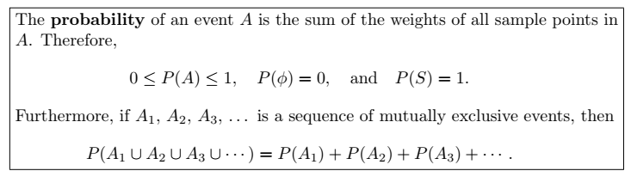

Slide 32
Examples (1 – 3)
A coin is tossed twice. What is the probability that at least 1 head occurs?
A die is tossed once. What is the probability of getting:
(a) an even number (b) a number less than 3 (c) a 4 or higher number (d) a 7 (e) A number from 1 to 6
3. A die is loaded in such a way that an even number is twice as likely to occur as an odd number. If E is the event that a number less than 4 occurs on a single toss of the die, find P(E).

Slide 33
Example 4
Two balanced dice are rolled once. What is the probability of getting
(a) A sum of 11 (b) same number on both dice (c) a sum of 13
Notes:
(a) 2/36=0.056 (b) 6/36=0.167 (d) 0

Slide 34
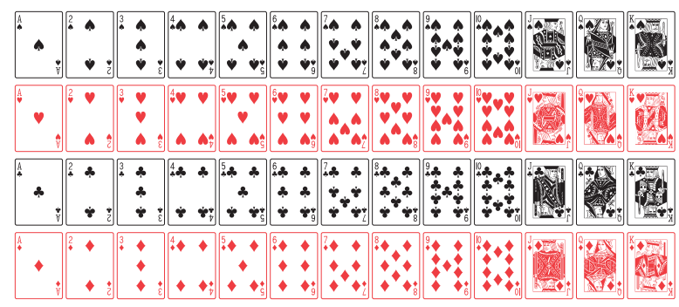
A deck of playing Cards

Slide 35
Example 5 – 6
5. A card is drawn at random from the well shuffled pack of 52 playing cards. Find the probability that the card:
(a) is a Jack (b) is not a Jack
6. In a poker hand consisting of 5 cards, find the probability of holding 2 aces and 3 jacks.
Notes:
(a) 4/52= (b) 12/13 (6) 24/2598960 = 0.00009

Slide 36
Example 7
A statistics class for engineers consists of 25 industrial, 10 mechanical, 10 electrical, and 8 civil engineering students. If a person is randomly selected by the instructor to answer a question, find the probability that the student chosen is (a) an industrial engineering major and (b) a civil engineering or an electrical engineering major.
Notes:
(a) 25/53 (b) P(C U E) = 18/53

Slide 37

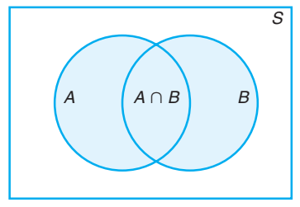
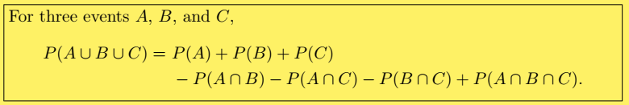
Additive Rule: Not - Mutually Exclusive Events

Slide 38
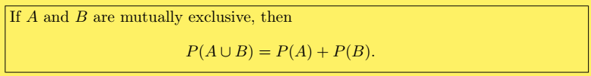
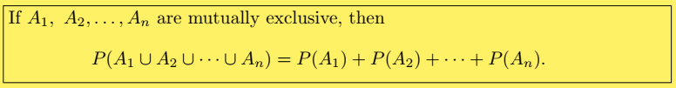
Additive Rule: Mutually Exclusive Events

Slide 39
Example # 08 – 10
8. John is going to graduate from an industrial engineering department in a university by the end of the semester. After being interviewed at two companies he likes, he assesses that his probability of getting an offer from company A is 0.8, and his probability of getting an offer from company B is 0.6. If he believes that the probability that he will get offers from both companies is 0.5, what is the probability that he will get at least one offer from these two companies?
What is the probability of getting a total of 7 or 11 when a pair of fair dice is tossed?
If the probabilities are, respectively, 0.09, 0.15, 0.21, and 0.23 that a person purchasing a new automobile will choose the color green, white, red, or blue, what is the probability that a given buyer will purchase a new automobile that comes in one of those colors?
Notes:
(8) 0.9 (not-Mutually) (9) (6 + 2)/36 (mutually)= 8/36 = 2/9 (10) Mutually = 0.68

Slide 40
Examples (11 – 12)
If the probabilities that an automobile mechanic will service 3, 4, 5, 6, 7, or 8 or more cars on any given workday are, respectively, 0.12, 0.19, 0.28, 0.24, 0.10, and 0.07, what is the probability that he will service at least 5 cars on his next day at work?
Suppose the manufacturer’s specifications for the length of a certain type of computer cable are 2000 ± 10 millimeters. In this industry, it is known that small cable is just as likely to be defective (not meeting specifications) as large cable. That is, the probability of randomly producing a cable with length exceeding 2010 millimeters is equal to the probability of producing a cable with length smaller than 1990 millimeters. The probability that the production procedure meets specifications is known to be 0.99.
(a) What is the probability that a cable selected randomly is too large? (b) What is the probability that a randomly selected cable is larger than 1990 millimeters?
Notes:
P(E’) = 0.12 + 0.19 = 0.31 P(E) = 1 – 0.31 = 0.69 (12) P(S) = P(L) = (1-0.99)/2 = 0.005 & P (X>1990) = 1 – P(S) = 1 – 0.005 = 0.995

Slide 41
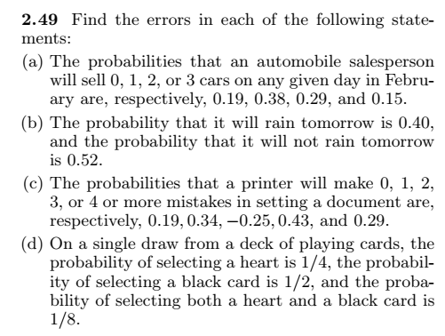
Exercises

Slide 42
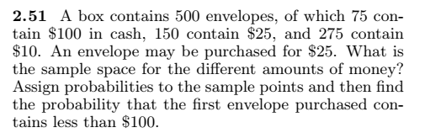
Notes:
S ={$10, $25, $100} 275/500 150/500 75/500 P(X<$100)=275/500 + 150/500 = 3/10

Slide 43

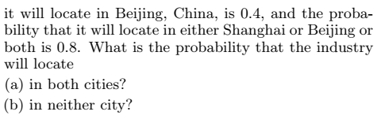
Notes:
(a) P(S&B) = 0.7 + 0.4 - 0.8 = 0.3 (non-mutually) (b) P(S’&B’) = 1 – P(SUB) = 1 – 0.8 = 0.2

Slide 44
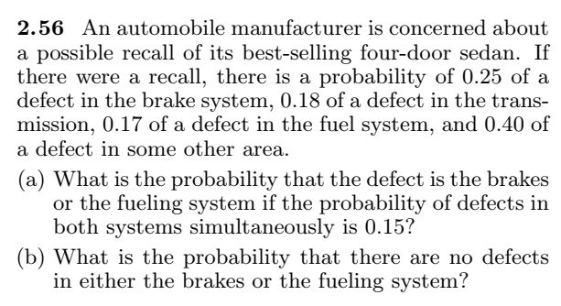
Notes:
A = Defect in brake, B = Defect in fuel, (a) P (A U B) = 0.25 + 0.17 – 0.15 = 0.27 (b) P (No defect ) = 1 – P(AUB) = 1 – 0.27 = 0.73
P(A’ U B’) = 1 - P(A intersection B)
P(A’ intersection B’) = 1 - P (A U B)

Slide 45
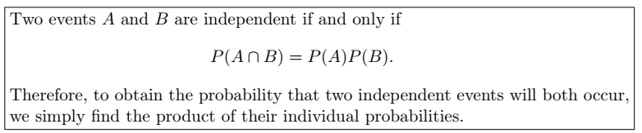
The Product Rule: Independent Events

Slide 46
Some important results for Independent events
(i) A’ and B are independent = P (A’∩ B ) = P(A’).P(B)
(ii) A and B’ are independent = P (A ∩ B’) = P(A).P(B’)
(iii) A’ and B’ are independent = P(A’ ∩ B’) = P(A’).P(B’)
If A and B are independent then they are not mutually exclusive.
If A, B, and C are independent, then P(A ∩B ∩ C)’ = 1 - P(A).P(B).P(C)
If A, B, and C are independent, then P (A U B U C) = 1 – P(A’ ∩ B’ ∩ C’)

Slide 47
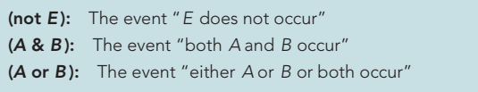
Relationship among events

Slide 48
Examples # 13 – 14
A small town has one fire engine and one ambulance available for emergencies. The probability that the fire engine is available when needed is 0.98, and the probability that the ambulance is available when called is 0.92. In the event of an injury resulting from a burning building, find the probability that both the ambulance and the fire engine will be available, assuming they operate independently.
A bag contains 5 red and 7 black balls. A ball is drawn at random from the bag, the color is noted and the ball is replaced. A second balls is then drawn. Find the probability that the first balls is red and the second is black.
Notes:
P(A&B) = 0.98*0.92 = 0.9016 (14) P(A&B) = 35/144

Slide 49
Examples 15 – 17
(15). A die is rolled two times. Find the probability of obtaining a 5 on the first thrown and an even number on the second thrown.
(16). The probability that Ahsan will be alive in 30 years is 0.4 and the probability that Bilawal will be alive in 30 years is 0.8. What is the probability that: (a) both will be alive in 30 years
(b) both of them die (c) Ahsan will be alive and B dead.
(17). A town has two fire engines operating independently. The probability that a specific engine is available when needed is
0.96.
(a) What is the probability that neither is available when needed? (b) What is the probability that a fire engine is available when needed?
Notes:
(15) [6/36]*[18/36] = ½ (16) (a) 0.32, (b) (0.6)*(0.2)=0.12, (c) (0.4)*(0.2) = 0.08
(17) P(neither available = A’&B”) = 1 – 0.96 = 0.004, (a) [0.04][0.04]=0.0016 (b)P(available when needed)=1 – P(A’&B’) = 1 – 0.0016 = 0.9984.

Slide 50
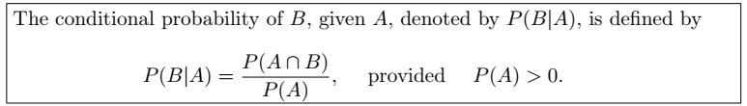
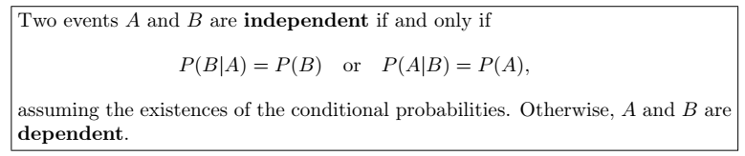
The Product Rule: Dependent Events

Slide 51
Example # 18
(18). Suppose that we have a fuse box containing 20 fuses, of which 5 are defective. If 2 fuses are selected at random and removed from the box in succession without replacing the first, what is the probability that both fuses are defective?
(19). Two cards are drawn in succession from a deck of 52 playing cards without replacement. What is the probability that both cards a are spades.
(20). A box contains 8 tickets bearing the numbers 1, 2, 3, 4, 5, 6, 8, 10. One ticket is drawn and kept aside. Then a second ticket is drawn. What is the probability that both the tickets show even numbers.
Notes:
(18) P(A&B) = [1/4][4/19]=1/19. (19). [13/52][12/51]= 1/17 (20). [5/8][4/7]= 5/14

Slide 52
Example # 21
(21). In a certain college 25% of the students passed Mathematics, 15% of the students passed statistics and 10% of the students passed both mathematics and Statistics. A students is selected at random.
(a) if he passed statistics, what is the probability that he passed mathematics.
(b) if he passed mathematics, what is the probability that he passed statistics.
(22). Suppose a pair of dice is tossed once. If it is known that one die shows a 3. what is the probability that other die shows a 6.
Notes:
(21) a. 0.10/0.15 = 2/3 (b) 2/5 (22) P(B\A) = [2/36]/11/36 = 2/11
P(6|3)=P(6 intersection 3) / P(3) =

Slide 53
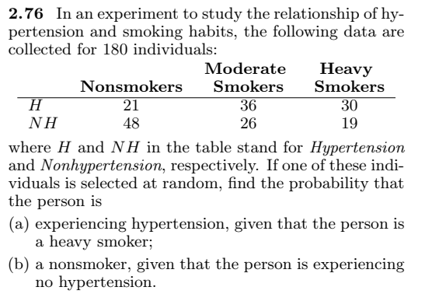
Example # 22
Notes:
P(A\B) = 30/49. P(c\A’)=48/93 total = 180

Slide 54
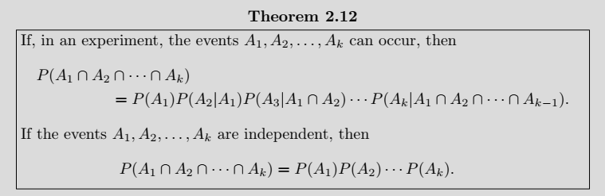
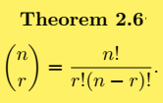

Example # 23
(2.91) Find the probability of randomly selecting 4 good quarts of milk in succession from a cooler containing 20 quarts of which 5 have spoiled, by using
(a) the first formula of Theorem 2.12 on page 68.
(b) the formulas of Theorem 2.6 and Rule 2.3 on pages 50 and 54, respectively.
Notes:
(a) (15/20)*(14/19)*(13/18)*(12/17) = 91/323 (b) 15C4/20C4 = 91/323 (c) n=15C4 & N=20C4

Slide 55
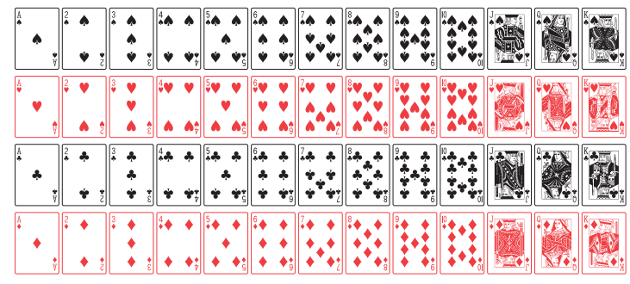

Slide 56
Example # 23
A card is drawn is random from a deck of ordinary playing cards. What is the probability that it is a diamond, a face card or a king?
Solution:
Let A = the card drawn is diamond
B = the card drawn is face card, &
C = the card drawn is a king
P (A U B U C) =
Notes:
P(A) = 13/52 P(B) = 12/52 P(C)=4/52 P(A∩B)=3/52 P(A∩C) = 1/52, P(B∩C) = 4/52, P(A∩B∩C) = 1/52
P (A U B U C ) = 22/52 = 0.423

Slide 57
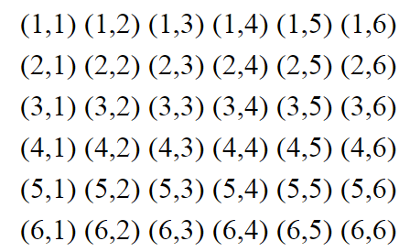
Example # 24
A man tosses two fair dice. What is the conditional probability that the sum of two dice will be 7, given that
(i) the sum is odd. (B)
(ii) the sum is greater than 6. (C)
(iii) the two dice had the same outcome. (D)
Solution:
Notes:
A=sum of two dice is 7
P(A) = 6/36 P(B) = 18/36 P(C)=21/36 P(D)=6/36 P(A∩B)=6/36
P(A∩C)= 6/36 P(A∩D)=0
P(A|B) = (6/36)*(36/18) = 1/3 P(A|C) = (6/36)*(36/21) P(A|D) = 0 * (36/6) = 0

Slide 58
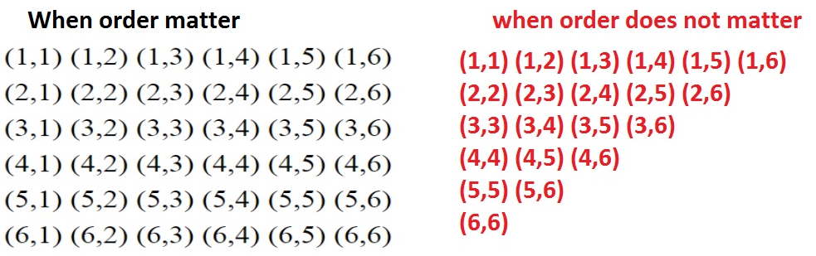

Slide 59
Example # 25
Two coins are tossed. What is the conditional probability that two heads results, given that there is at least one head?
Notes:
P(A∩B) = ¼ = {HH} P(B) = ¾ P(A|B) = 1/3

Slide 60
Example # 25
Two events A & B are such that P(A) = 1/4, P(A|B)=1/2, P(B|A) = 2/3
Are A and B independent events?
Are A and B mutually exclusive events?
Find P(A∩B)
Solution:
Notes:
(i) Not independent, P(A) not equal to P(A|B) (ii) if mutually exclusive then it should be P(A|B) = 0 but here P(A|B) = 1/2 (iii) P(A∩B)=P(A).P(B|A) = (1/4)*((2/3) = 1/6

Slide 61
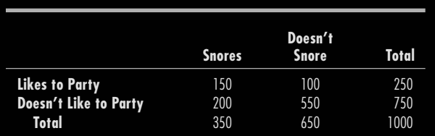



Example: Roommate Compatibility
Baber is off to college. There are 1000 additional new male students, and one of them will be randomly assigned to share Baber’s dorm room. He is hoping that it won’t be someone who likes to party or who snores. The table for the 1000 students is given below. What is the probability that Baber will be disappointed and get a roommate who either likes to party or snores or both?
Notes:
P(Baber will be disappointed) = 0.45
P(Baber get a roommate who is acceptable) = 1 - 0.45 = 0.55

Slide 62
Example # 26
In a certain assembly plant, three machines, B1, B2, and B3, make 30%, 45%, and 25%, respectively, of the products. It is known from past experience that 2%, 3%, and 2% of the products made by each machine, respectively, are defective. Now, suppose that a finished product is randomly selected. What is the probability that it is defective?
Solution:
A: the product is defective, B1: the product is made by machine B1, B2: the product is made by machine B2, B3: the product is made by machine B3,
Notes:
P(D1|B1) + P(D2|B2) + P(D3|B3) = (0.3)*(0.02) + (0.45)*(0.03) + (0.25)*(0.02) = 0.0245.

Slide 63
Tree Diagram for Example # 26
P(A|B1) = 0.02
P(B1) = 0.3
P(A|B2) = 0.03
P(B2) = 0.45
P(B3) = 0.25
P(A|B3) = 0.02

Slide 64
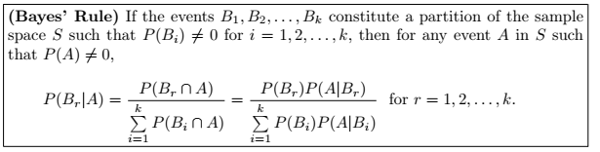
Baye’s Rule

Slide 65

Example # 27
In a certain assembly plant, three machines, B1, B2, and B3, make 30%, 45%, and 25%, respectively, of the products. It is known from past experience that 2%, 3%, and 2% of the products made by each machine, respectively, are defective. Now, suppose that a finished product is randomly selected. What is the probability that it is defective? if a product was chosen randomly and found to be defective, what is the probability that it was made by machine B3?
Solution:
Notes:
P(B3|A) = 0.005/(0.006)+(0.0135)+(0.005) = 0.005/0.0245 = 10/49

Slide 66
Example # 28
Suppose a Software House based in Karachi required the post of Programmer. After interviewing many applicants, the firm has identified 20 applicants categorized as in the following contingency table:
If a diploma holder is selected, what is the probability that the person is a Male.
 | Certificate | Diploma | Total
Male | 10 | 2 | 12
Female | 5 | 3 | 8
Total | 15 | 5 | 20
Notes:
P(D) = P(D∩M) + P(D∩F) = 0.10 + 0.15 = 0.25 P(M∩B) = 0.10 P(M|D) = 0.10/0.25 = 0.4

Slide 67
Example # 29
Suppose 25 colored balls are distributed in three bags, which are identical in appearance as follows:
A bag is selected as random from which a ball is drawn at random.
Find the probability that the ball is yellow.
Given that ball is yellow, what is the probability that bag 2 was selected.
 | BAG
 | 1 | 2 | 3 | Total
Green | 1 | 3 | 4 | 8
Yellow | 2 | 2 | 3 | 7
Red | 4 | 5 | 1 | 10
Total | 7 | 10 | 8 | 25
Notes:
P(B1=B2+B3) = 1/3, (a) P(Y) = P(B1∩Y) + P(B2∩Y) + P(B3∩Y) = 0.2869 (B) PB2|Y) = (1/3)*(2/10)/0.2869 = 0.23

Slide 68
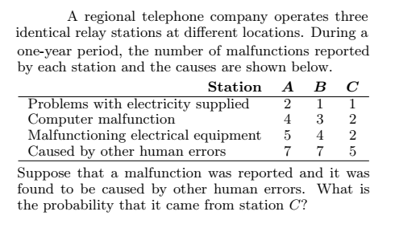
Notes:
0.2632 = P(C|E)
Grant total = 43, HumanErrorTotal = 19

Slide 69
Prove rules of Multiplication for probability
Suppose A & B represent two events, then
P(A∩B) = P(A).P(B|A) 🡪 dependent events
P(A∩B) = P(A).P(B) 🡪 independent events
Proof:

Slide 70
Prove that P(A|B) = P(A) for independent events

Slide 71
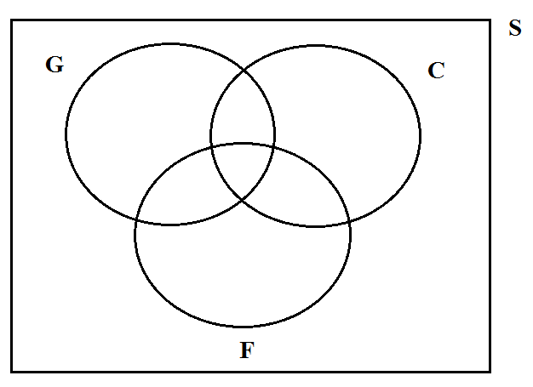
Miscellaneous Problems
Q1) In a survey on 136 boys, 67 played golf, 56 played cricket and 40 played football 11 played both golf and cricket, 12 played both cricket and football and 9 played both golf and football. Each boy played at least one of these games. How many played all the three games. (use Venn diagram)
n(S) = 136
n(G) = 67
n(C) = 56
n(F) = 40
n(G & C) = 11
n(C & F) = 12
n(G & F) = 9
n(G & F & C) = x = ?
47+x
11-x
33+x
x
9-x
12-x
19+x
Notes:
X = 5 played all three games.

Slide 72
Miscellaneous Problems (Contd.)
Q2) A newsagent sells three papers, the Jang, the Dawn, and the BR, 70 customers buy the Jang, 60 the Dawn, and 50 the BR, 17 buy both the Jang & Dawn, 15 the Dawn & the BR, and 16 the BR & the Jang, while 3 customers buy all three papers. How many customers has he?
Q3) A total of 365 Capsules, each marked by the difference dates of the year, are mixed and one capsule is picked at random. What is the probability that the capsule picked will be of:
A day of January
March 2
Either of March or April
Not of December
Notes:
(2)Total customers = 135 (Q3) (i) 31/365, (ii) 1/365 (iii) 61/365 (iv) 334/365

Slide 73
Miscellaneous Problems (Contd.)
Q4) How many three-digit numbers can be formed from the digits 0, 1, 2, 3, 4, 5, and 6 if each digit can be used only once?
(b) How many of these are odd numbers? (c) How many are greater than 330?
Q5) How many number each of 5 different digits can be formed from the digits 0, 4, 5, 6, & 7, if
(a) the digits 4 and 5 are to be next to each other,
(b) the digits 4 and 5 are not to be next to each other
Notes:
Q4) 180, 75, 105 (Q5) (a) 36, (b) total ways = 96, 96-36=60

Slide 74
Miscellaneous Problems (Contd.)
Q6) How many permutations can be obtained from the letters in ARTICLE, if
(a) Consonants occupy the odd places
(b) R and T occupy the ends
(c) T and C come together
Notes:
Q6) 144, 240, 1440

Slide 75
Miscellaneous Problems (Contd.)
Q7) Find the number of four letter words that can be formed from the letters for the word SOCIETY.
(a) how many of them contain only consonants.
(b) how many of them begin and end in a consonant.
(c) how many of them begin with a vowel.
(d) how many contain the letter E.
(e) how many begin with Y and end in a vowel.
(f) how many begin with Y and also contain T.
(g) how many contain one vowel.
Notes:
840 (a) 24 (b)240 (c) 360 (d) 480 (e) 60 (f)60 (g) 288

Slide 76
Miscellaneous Problems (Contd.)
Q8) The probabilities that three men hit a target are respectively 1/6, 1/4 and 1/3. Each shoots once at the target. If only one hit the target, what is the probability that it was the first man.
Notes:
P(M1)= 6/72 P(M2)=10/72 P(M3)=15/72 P(M1 \ One Hit) = 6/31=0.1935

Slide 77
Miscellaneous Problems (Contd.)
Q9) A box contains 24 transistors, four of which are defective. If four are sold at random, find the following probabilities.
(a) Exactly two are defective
(b) all are defective
(c) none is defective
(d) at least one is defective
Notes:
(a) P(X=2) = [4c2 * 20c2/24c4]=1140/10626 (b) 1615/3542 (c) 1/24c4=(1/10626) (d) P(at least 1 d)=1 – P(no defective) = 1927/3542

Slide 78
Miscellaneous Problems (Contd.)
Q10) There are eight married couples in a tennis club. If one man and one woman are selected at random to plan the summer tournament, find the probability that they are married to each other.
Notes:
8.8=64 ways to select men and women, 8/64=1/8

Slide 79
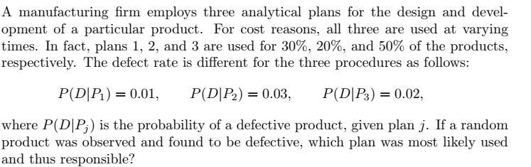
Miscellaneous Problems (Contd.)
Q11)
Notes:
P(P1|D)=0.158; P(P2/D)=0.316 P(P3/D)=0.526 since P(P3/D) is largest of the three, thus a defective is most likely the result of the use of plan 3

Slide 80
Miscellaneous Problems (Contd.)
Q12) The probabilities that a service station will pump gas into 0, 1, 2, 3, 4, or 5 or more cars during a certain 30-minute period are 0.03, 0.18, 0.24, 0.28, 0.10, and 0.17, respectively. Find the probability that in this 30-minute period. (a) more than 2 cars receive gas; (b) at most 4 cars receive gas; (c) 4 or more cars receive gas.

Slide 81
Miscellaneous Problems (Contd.)
Q13) Police plan to enforce speed limits by using radar traps at four different locations within the city limits. The radar traps at each of the locations L1, L2, L3, and L4 will be operated 40%, 30%, 20%, and 30% of the time. If a person who is speeding on her way to work has probabilities of 0.2, 0.1, 0.5, and 0.2, respectively, of passing through these locations, what is the probability that she will receive a speeding ticket?
Notes:
P(R)=sum{P(R|Si)P(Si) = 0.4*0.2+0.3*0.1+0.2*0.5+0.3*0.2 = 0.27

Slide 82
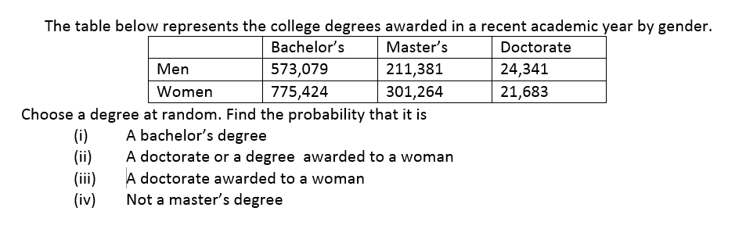
Miscellaneous Problems (Contd.)

Slide 83
In how many ways a cricket eleven be chosen out of 14 players? How many of them will:
(i) include a particular player
(ii) exclude a particular player
Notes:
364 286 78

Slide 84
Miscellaneous Problems (Contd.)
Q15) Suppose that we have 3 cards that are identical in form, except that both sides of the first card are colored red, both sides of the second card are colored black, and one side of the third card is colored red and the other side black. The 3 cards are mixed up in a hat, and 1 card is randomly selected and put down on the ground. If the upper side of the chosen card is colored red, what is the probability that the other side is colored black?
Notes:
1/3 = [(1/2)*(1/3) / 1(1/3)+(1/2)*(1/3)+ 0(1/3)]
Bayes’ rule
Sample Space = (RR, BB, RB) = (C1, C2, C3)

